Slide 1


Report: an evaluation of the risk of airborne transmission of COVID-19 on the 802 train carriage
Huw Woodward, Rick de Kreij, Laetitia Mottet, Emily Kruger, Sarkawt Hama, Arvind Tiwari, Prashant Kumar,
Christopher Pain, Paul Linden
TRACK WP5
1

Slide 2
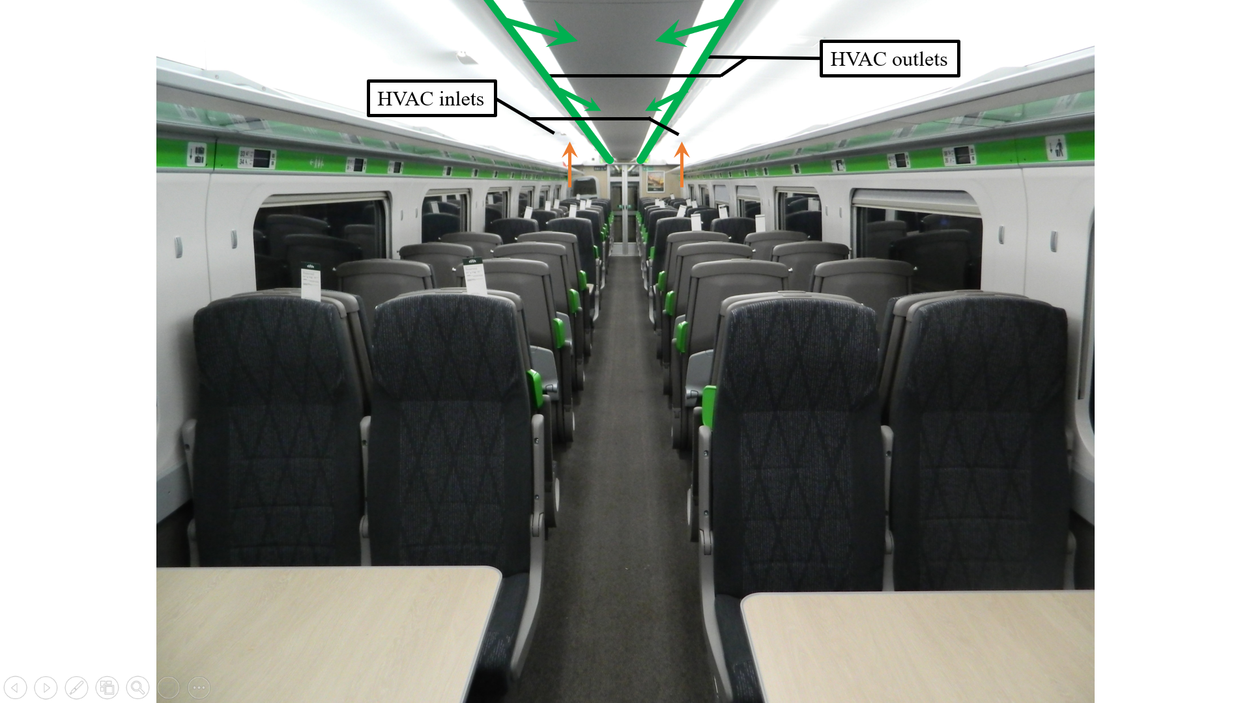
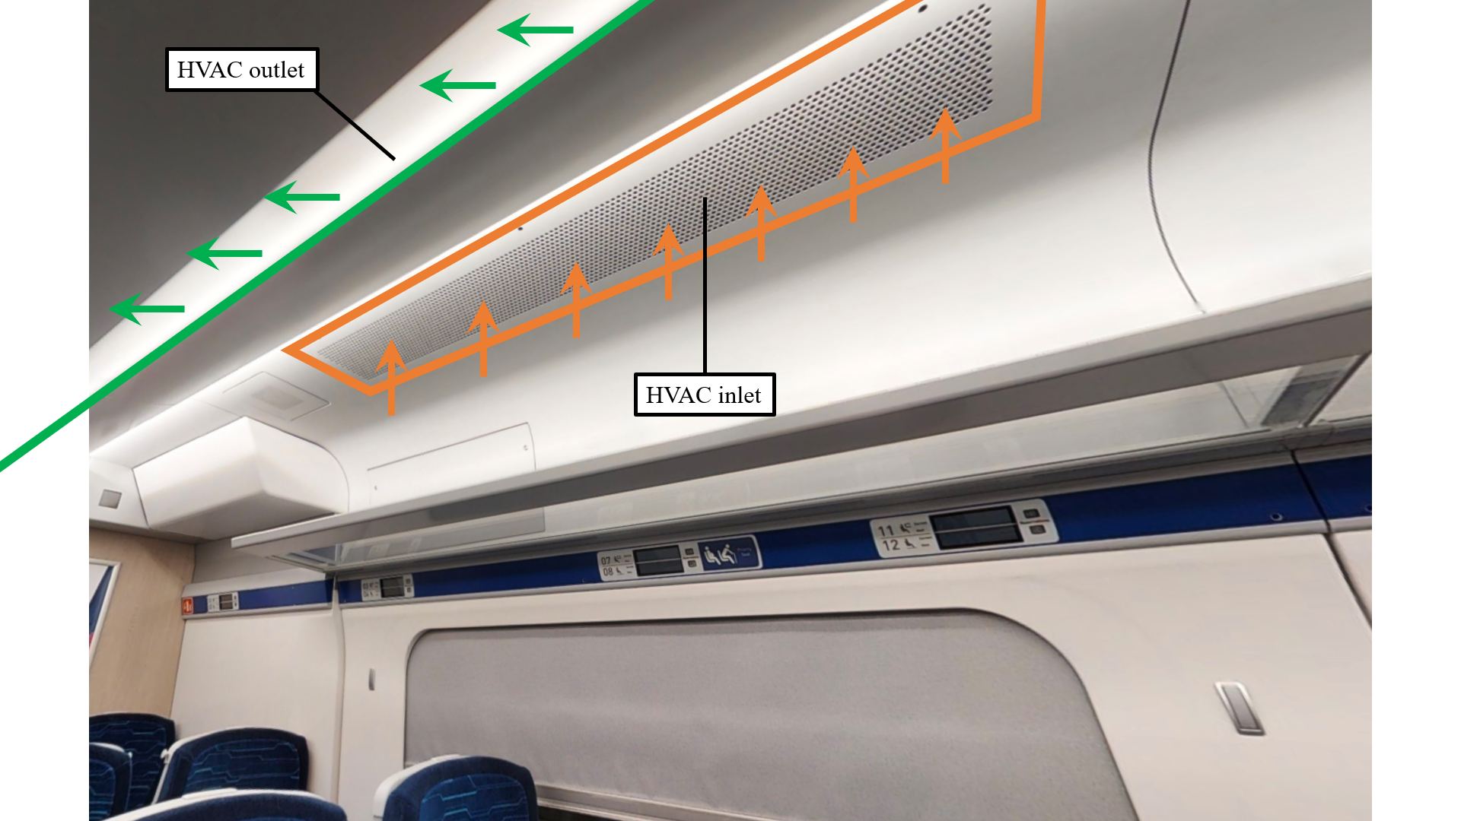


Report objectives
What is our best estimate of the risk of infection via the airborne route?
What is the infection rate integrated over all passengers?
To what extent does this risk depend on the location of the infected person and other passengers?
Is the well-mixed assumption suitable to estimate the risk of airborne transmission?
2

Slide 3
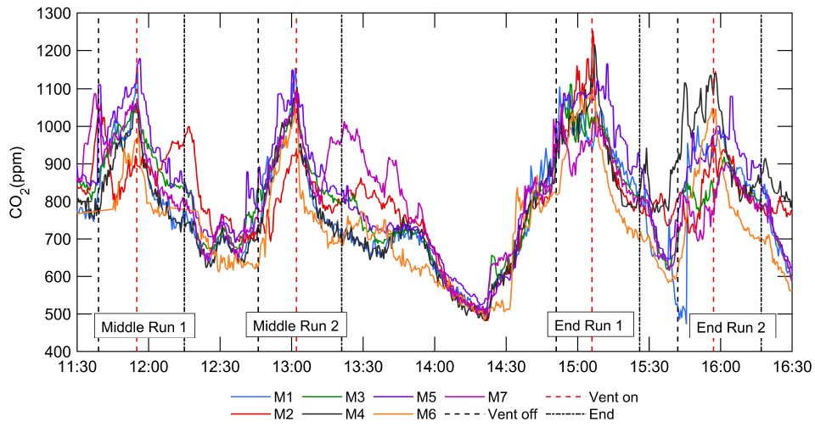
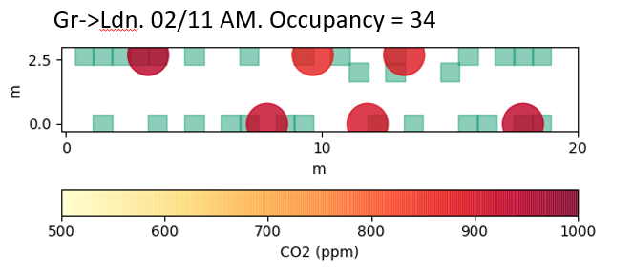
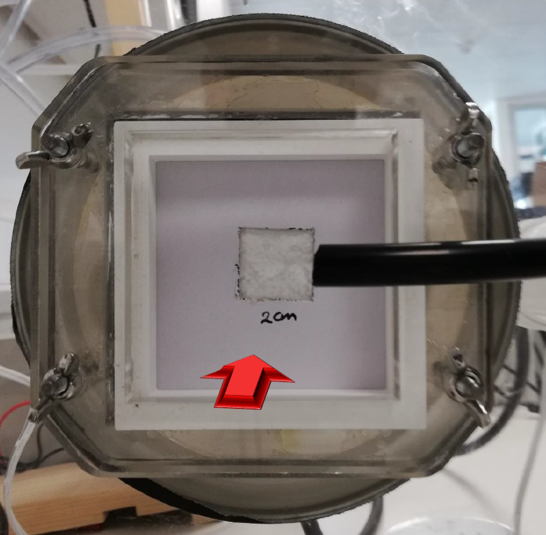
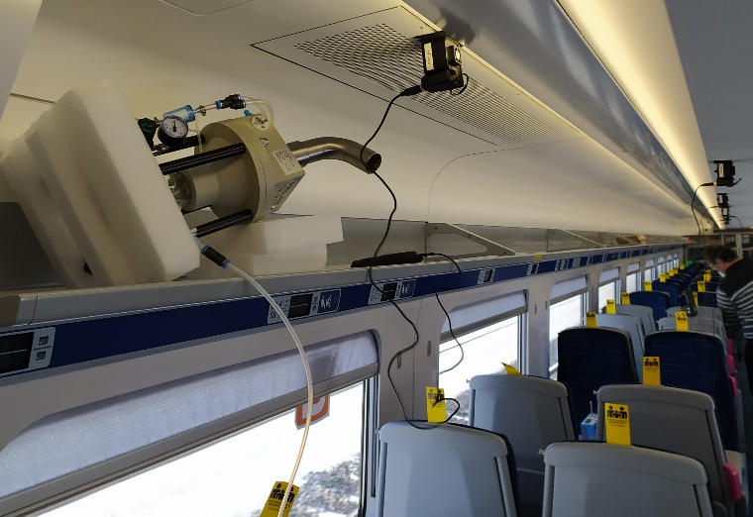
Conducted experiments
1
2
CO₂ measurements for a controlled experiment during Autumn 2020
In-service CO₂ measurements taken in November 2020 over the course of 2 days
Measurements of the concentrations of salt aerosol droplets released from a nebuliser during February 2021
HVAC filter efficiency tests
4
3
3

Slide 4
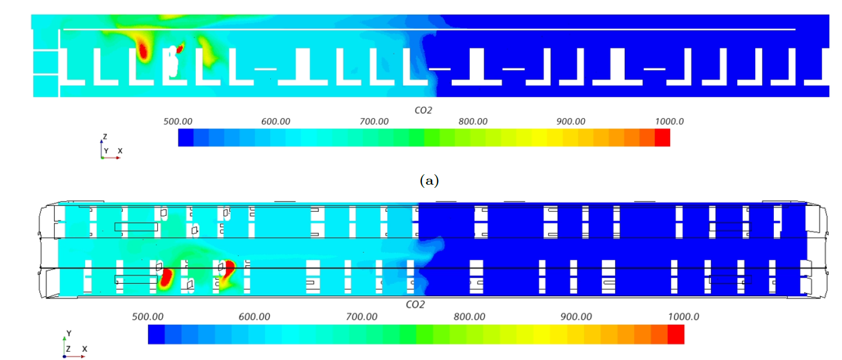
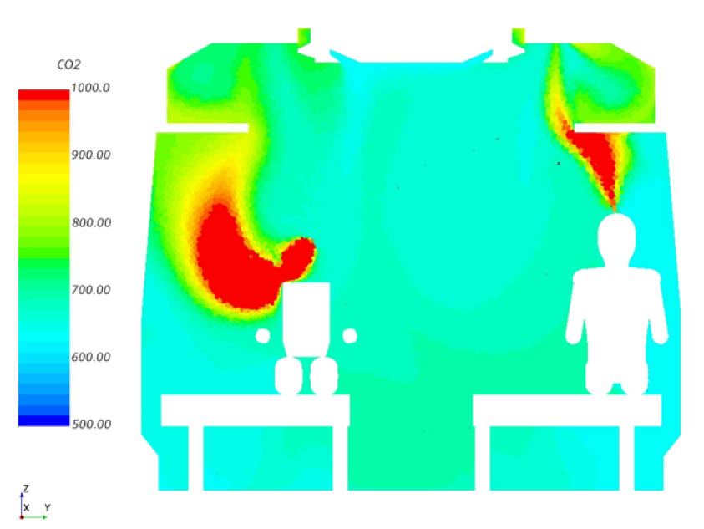
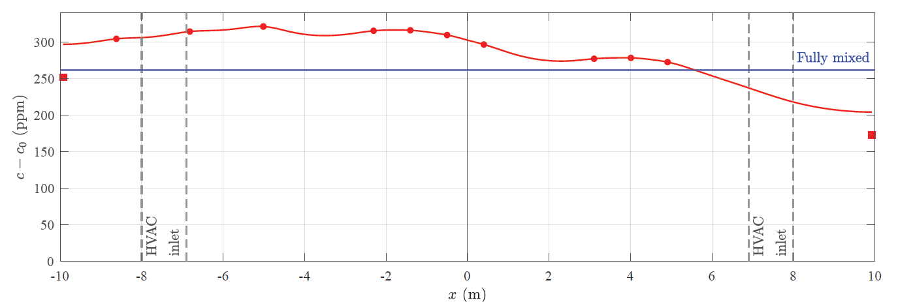
Modelling
CFD simulation of controlled CO₂ experiments
1D diffusion-advection contaminant model
1
2
4

Slide 5
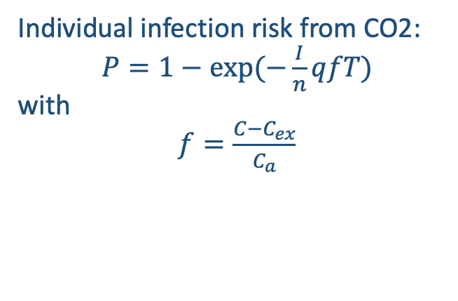
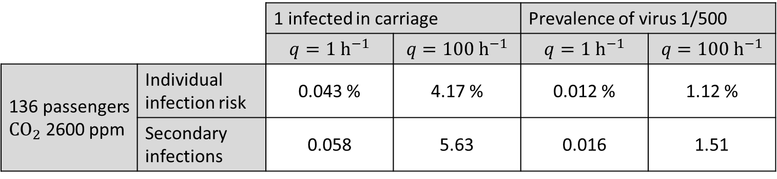
Risk and secondary infections estimates from CO₂
In service estimation:
Viral load will vary per person
Quanta released depends on activity level
Individual infection risk from CO2:
$P=1−exp⁡(−\frac{I}{n}qfT)$
with
$f=\frac{C−C_{ex}}{C_{a}}$
 |  | 1 infected in carriage |  | Prevalence of virus 1/500
 |  | $$q=1 h^{−1}$$ | $$q=100 h^{−1}$$ | $$q=1 h^{−1}$$ | $$q=100 h^{−1}$$
136 passengers $CO_{2}$ 2600 ppm | Individual infection risk | 0.043 % | 4.17 % | 0.012 % | 1.12 %
 | Secondary infections | 0.058 | 5.63 | 0.016 | 1.51
5

Slide 6
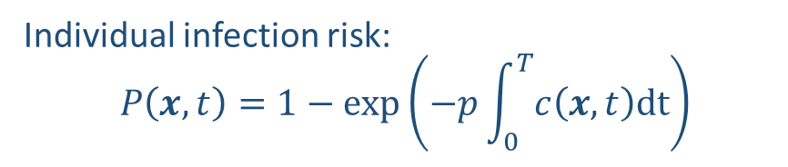
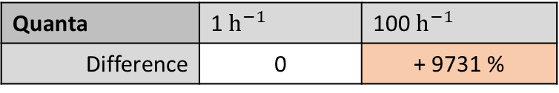
Infection risk dependence
Individual infection risk:
$$P\left(x,t\right)=1−\exp\left(−p\int_{0}^{T}{c\left(x,t\right)dt}\right)$$
Individual infection risk is estimated with fully mixed and 1D model
Base configuration “0”: infection probability 0.056 %
Quanta | 1 $h^{−1}$ | 100 $h^{−1}$
Difference | 0 | + 9731 %
Average risk of 1D model for an unknown source location equals risk of fully mixed model
Except when physical distancing is included
Source location | Centre | Average of all locations | End
Difference | + 28 % | 0 | - 49 %
Ventilation rate | No ventilation | Operational | Maximum
Difference | + 229 % | 0 | - 51 %
Physical distancing | 0 rows | 1 row | 2 rows | 3 rows
Difference | 0 | - 6 % | - 14 % | - 22 %
Journey duration | ½ hour | 1 hour | 2 hours
Difference | - 58 % | 0 | + 117 %
Filtration | No filtration | 1 filter (10%) | 2 filters (20%) | Full removal (100%)
Difference | 0 | - 13 % | - 23 % | - 61 %
6

Slide 7
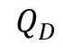

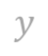
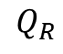


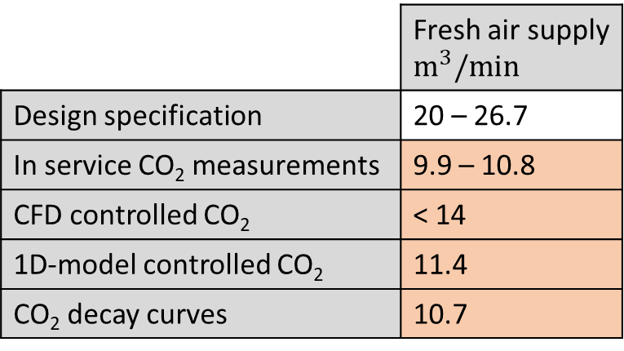
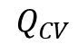
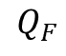
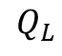
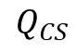
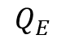
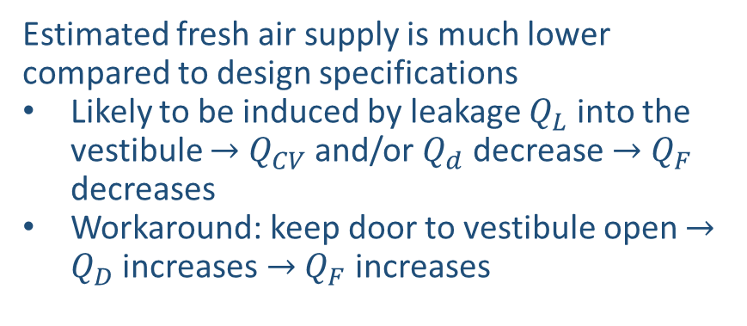
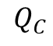

Concerns HVAC design and possible workaround
$$HVAC SOUTH$$
Estimated fresh air supply is much lower compared to design specifications
Likely to be induced by leakage $Q_{L}$ into the vestibule $→$ $Q_{CV}$ and/or $Q_{d}$ decrease $→$ $Q_{F}$ decreases
Workaround: keep door to vestibule open $→$ $Q_{D}$ increases $→$ $Q_{F}$ increases
$$Q_{E}$$
$$Q_{F}$$
FRESH-AIR
$$z$$
$$Q_{R}$$
$$Q_{C}$$
 | Fresh air supply $m^{3}/min$
Design specification | 20 – 26.7
In service CO₂ measurements | 9.9 – 10.8
CFD controlled CO₂ | < 14
1D-model controlled CO₂ | 11.4
CO₂ decay curves | 10.7
$$Q_{CV}$$
$$Q_{CS}$$
$$Q_{L}$$
$$Q_{D}$$
$$y$$
$$VESTIBULE$$
$$\text{½} SALOON$$
7

Slide 8
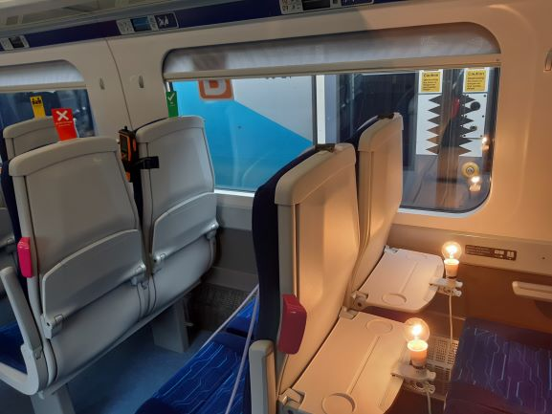
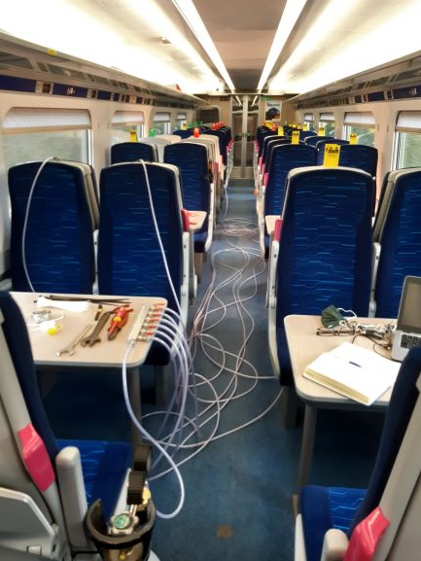
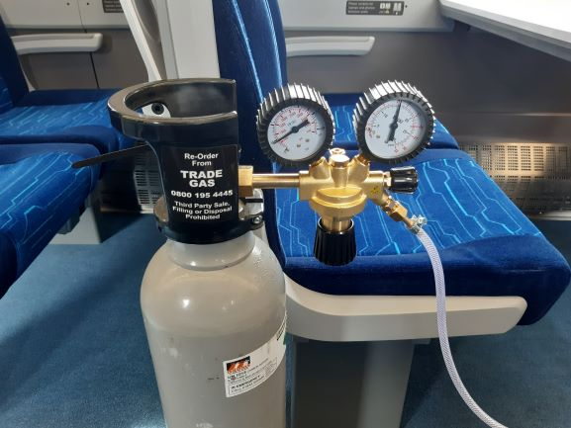
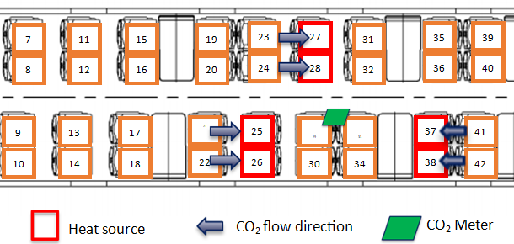
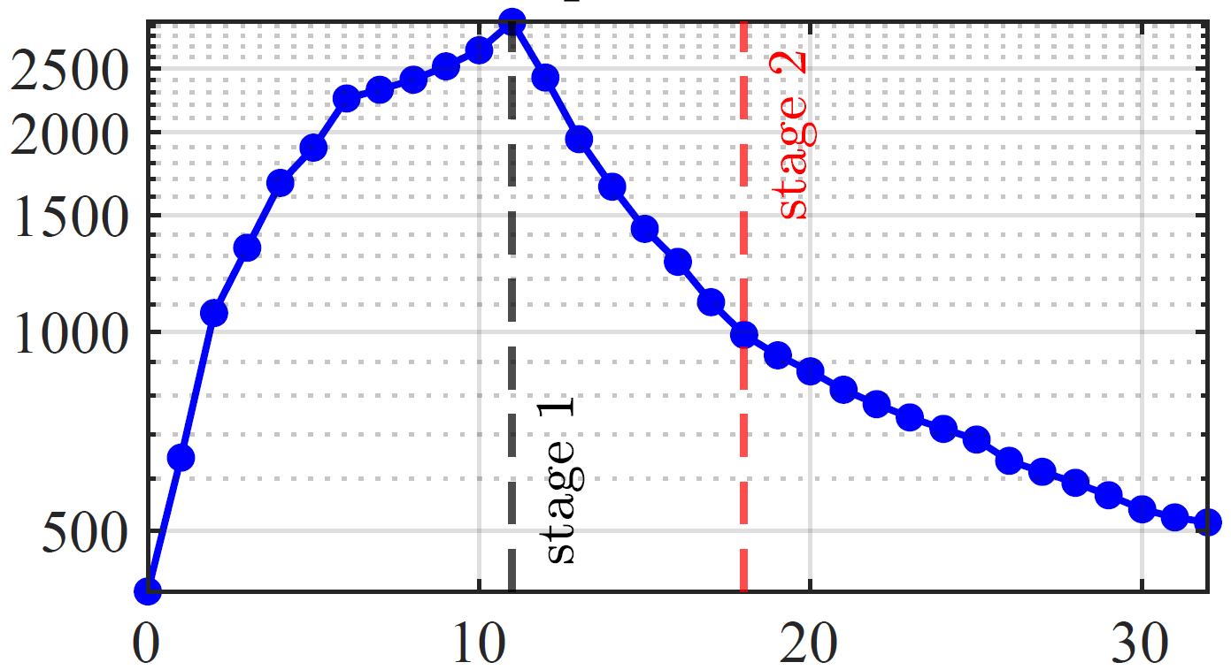
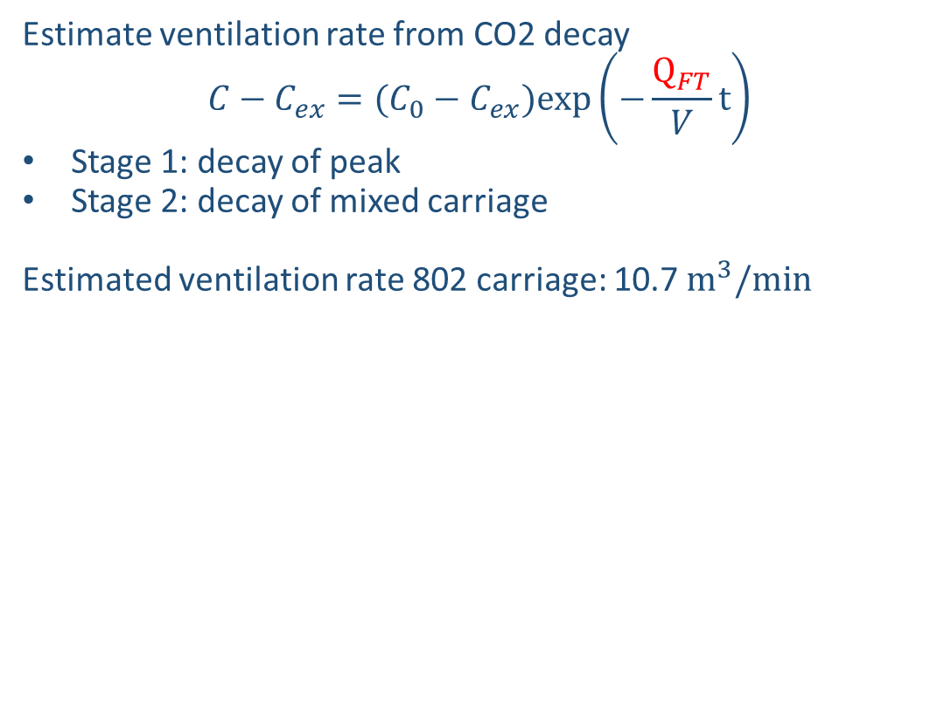
Measurements conducted by
Jonathan Bridgewood - Group Rail Technical Director
A methodology for evaluating the effective ventilation rate within public transport vehicles
Estimate ventilation rate from CO2 decay
$$C−C_{ex}=(C_{0}−C_{ex})exp\left(−\frac{Q_{FT}}{V}t\right)$$
Stage 1: decay of peak
Stage 2: decay of mixed carriage
Estimated ventilation rate 802 carriage: 10.7 $m^{3}/min$
Improve method:
More sensors
Higher concentrations
Longer measurement duration
8

Slide 9
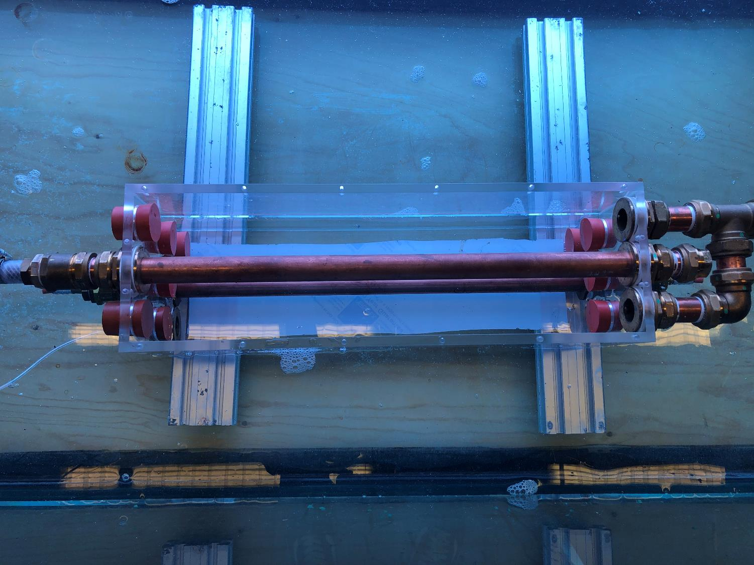
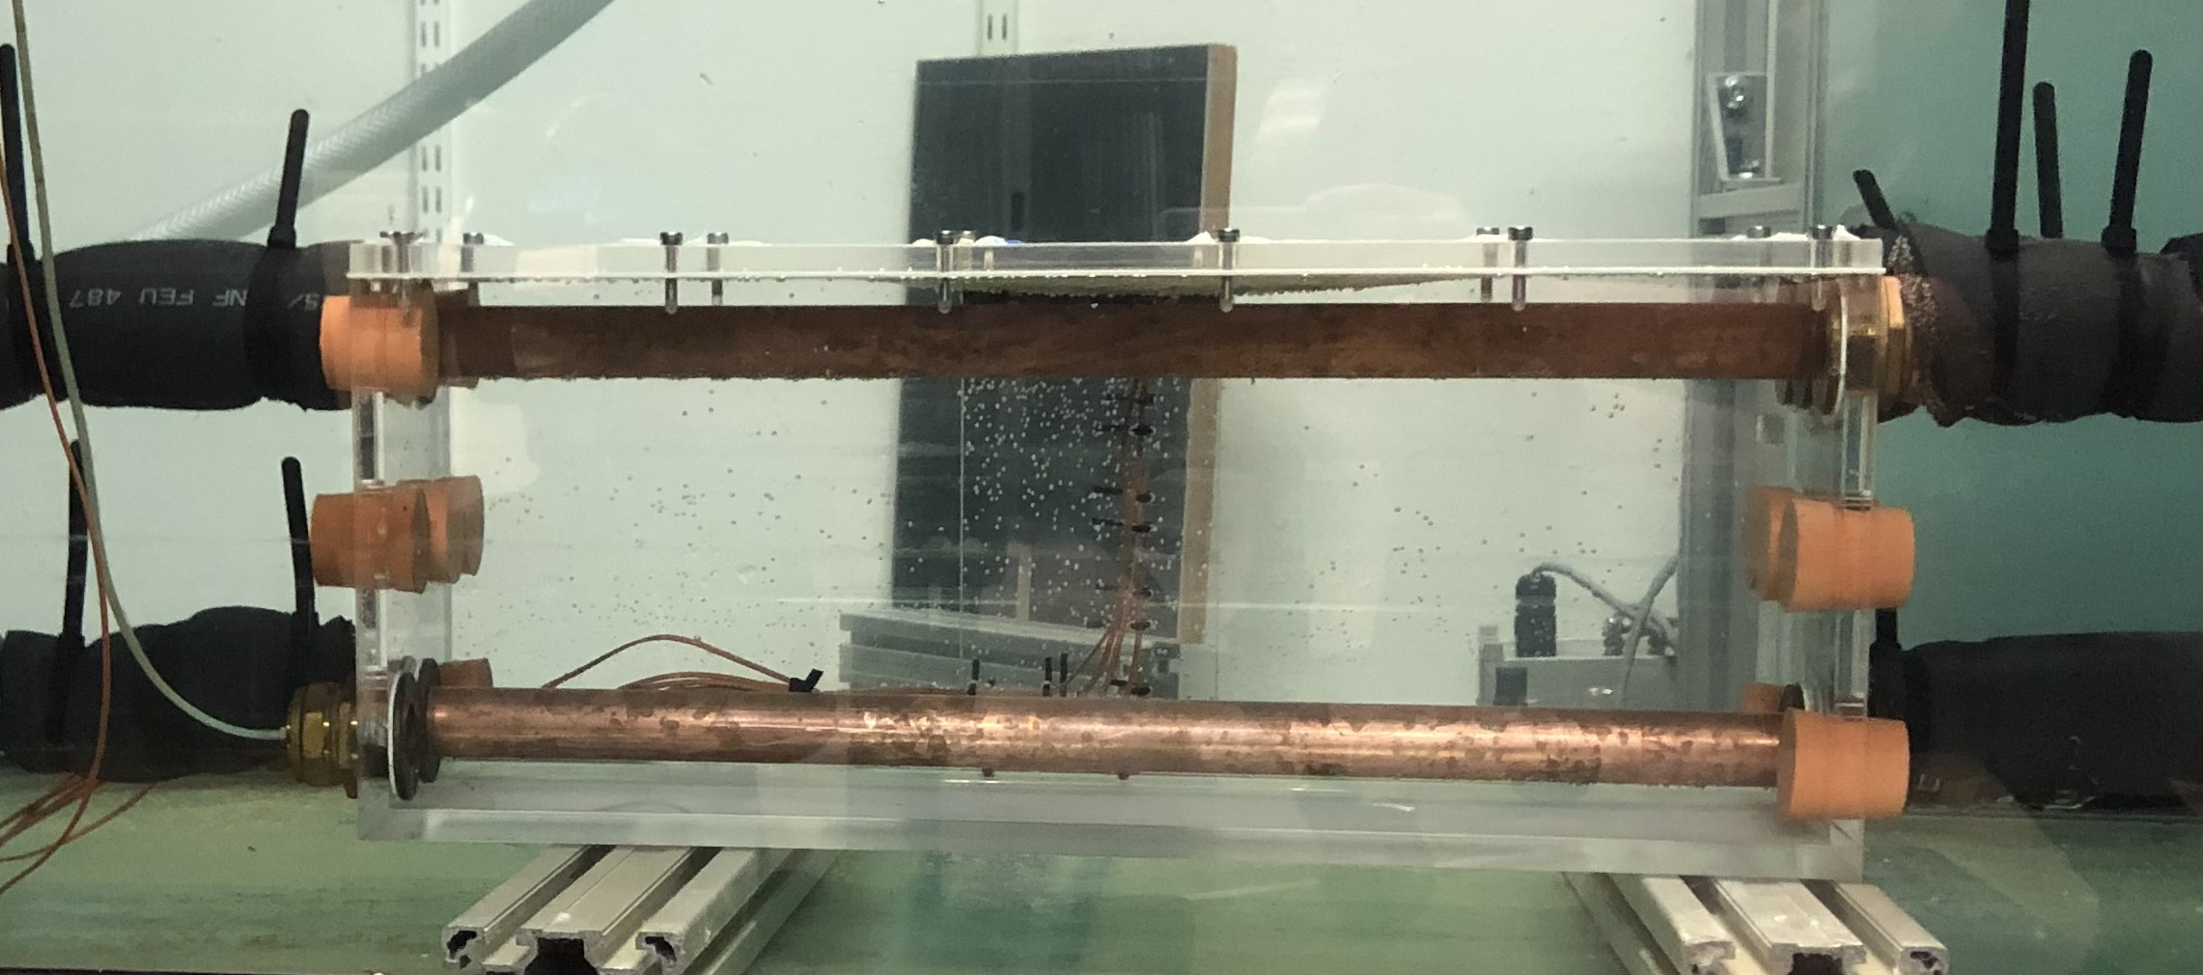


Laboratory Experiments
F
Flow meter
Fresh In
Thermocouple
50cm
Outflow
Tank Inflow
Inflow
Tank Outflow
15cm
Waste
F
Inflow
Outflow
F
20cm
Heated Pipe

Slide 10
Scalings
Volume Fluxes per unit length:
Momentum Flux per unit length from top:
Buoyancy Flux per unit length from bottom:
Jet Length:
Mixed Flow:
Stratified Flow:
$$Q_{t}, Q_{b}$$
$$M_{t}=Q_{t}^{2}b$$
L
$$F_{b}= \frac{gβρ_{b}ΔTQ_{b}}{ρ_{a}}$$
$$L_{j}= \frac{M_{t}}{F_{b}^{2/3}}$$
H
Heated Pipe
$$\frac{L_{j}}{H} ≫ 1 ⟹ Q_{t}≫{\left(bH\right)}^{1/2}F_{b}^{1/3}$$
$$\frac{L_{j}}{H} ≪1 ⟹ Q_{t}≪{\left(bH\right)}^{1/2}F_{b}^{1/3}$$

Slide 11
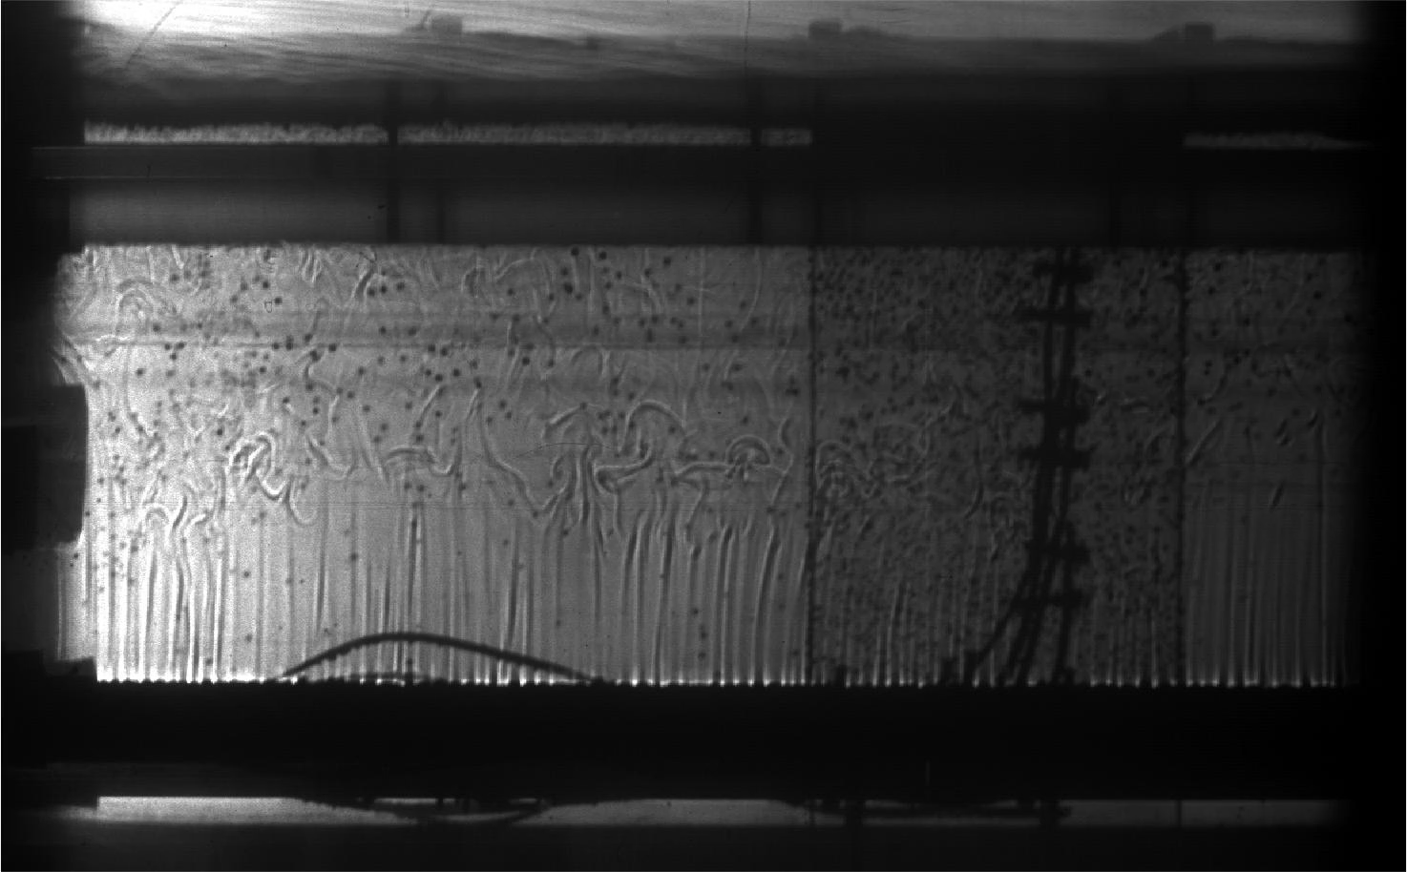
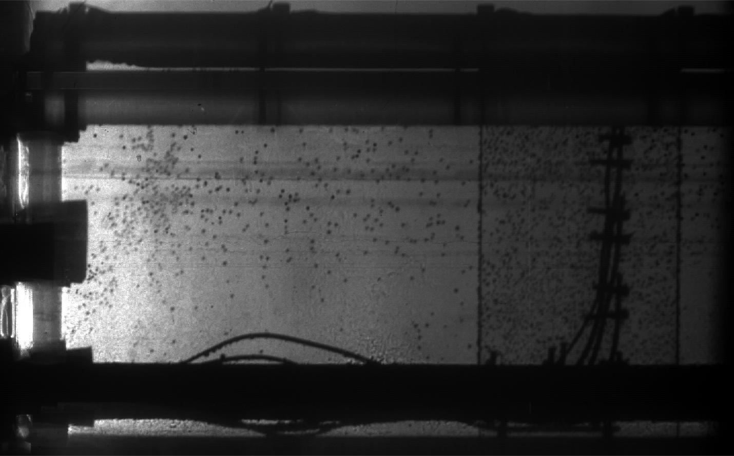
Example Experiments
$$\frac{L_{j}}{H} ≪ 1$$
$$\frac{L_{j}}{H} ≫ 1$$

Slide 12
Example Temperature Measurements
$$\frac{L_{j}}{H} ≪ 1$$
$$\frac{L_{j}}{H} ≫ 1$$

Slide 13
Limitations and future work
Lack of experimental or CFD analysis for a carriage with high occupancy
1D model assumes well mixed across its cross-section (might change with heating and/or high occupancy)
Awaiting results of nebuliser measurements February
Quantify the effect of opening/closing doors
Estimate HVAC filtration efficiency
Estimate infection risk in both longitudinal and lateral directions
Verify zonal model (extension of 1D advection-diffusion model)
13

